Slide 1
Geospatial Hadoop
Junjun Yin
Social Science Research Institute
Pennsylvania State University, university park, PA, 16801
jyin@psu.edu
January 30, 2017

Slide 2
Outline
Geospatial Big Data
Geo-located Twitter data streams
New York taxi trip record data (http://www.nyc.gov/html/tlc/html/about/trip_record_data.shtml)
CyberGIS
Distributed computing environment in ROGER
Apache Hadoop and HDFS
Big Data processing in Hadoop Distributed File System (HDFS)
MapReduce (Java) with geospatial operations (ESRI shapefile)
Hive
Hadoop streaming API with Python
Notes:
Can you give some examples about geospatial Big Data

Slide 3

A beautiful planet
Source: http://www.slashfilm.com/a-beautiful-planet-trailer/

Slide 4
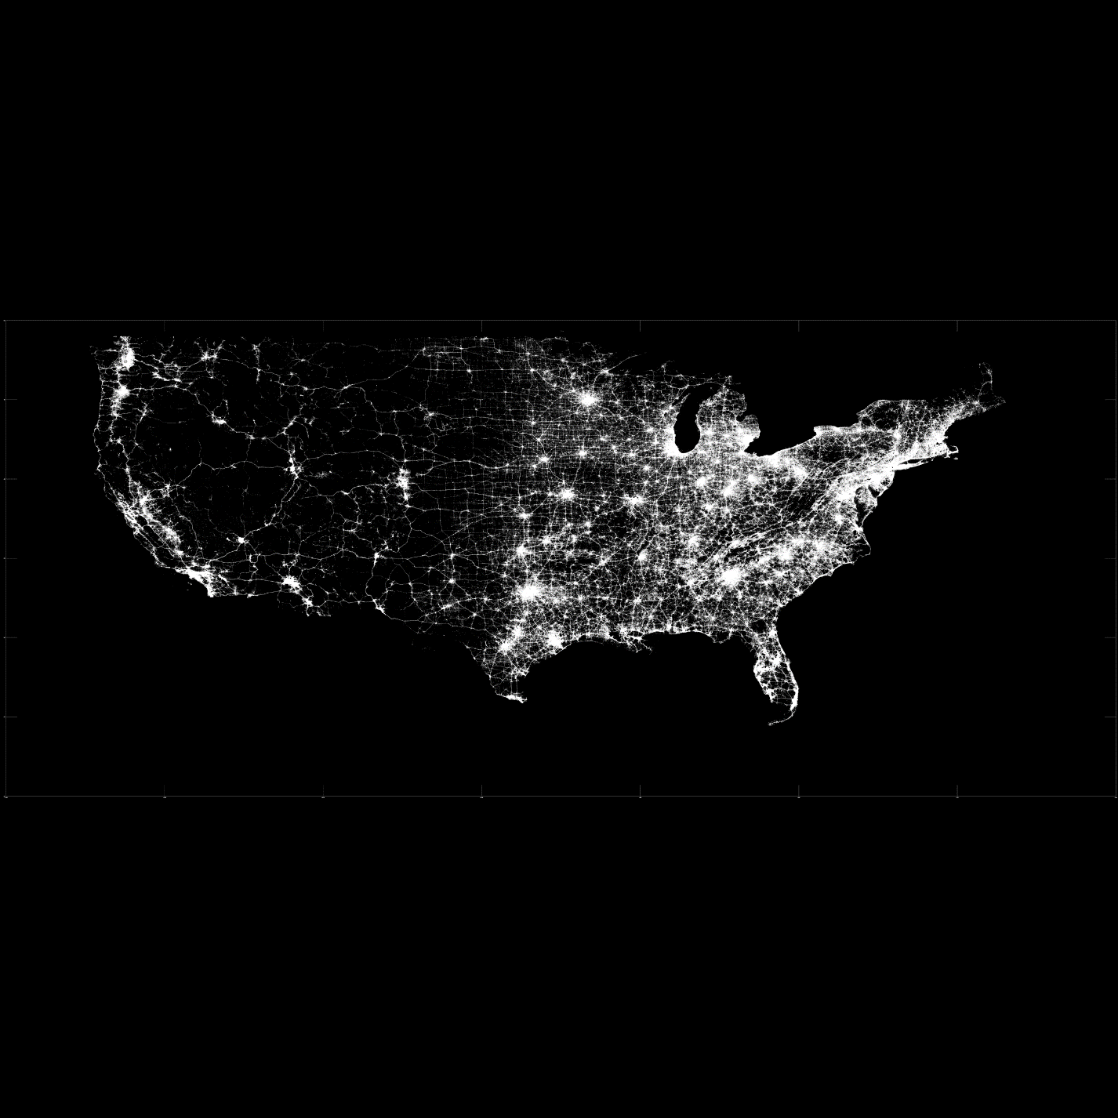
A map is worth a thousand words
An image of geo-located Twitter data covering the Contiguous United States

Slide 5

Geospatial Big Data: NYC taxi trip records
An example visualization of New York taxi trip record data
The black pixel means the taxi did not have fare and yellows means it did
Source: http://chriswhong.com/open-data/my-first-data-art-nyc-taxi-defrag/
Notes:
Each row represents one taxi, each pixel is one minute and 60 minutes, 12 hours a day.

Slide 6

CyberGIS
CyberGIS is Geographic Information Science and Systems based on advanced cyberinfrastructure.
Why CyberGIS?
Geospatial discovery and innovation with advanced digital technologies¹
Big data
Big compute
CyberGIS
Big collaboration
Big problems
1. Wang, S. (2013) “CyberGIS: Blueprint for Integrated and Scalable Geospatial Software Ecosystems.” International Journal of Geographical Information Science, 27 (11): 2119-2121
Notes:
CyberGIS more focuses on Spatial thinking.
These advanced technologies not only bring forth computational
innovation such as geospatial optimization and simulation, but also
yield actionable insight from big data. GIScience therefore seeks today to resolve
problems of dealing with and analyzing heterogeneous spatial data, integrating
and synthesizing diverse data sources, and orchestrating collaboration, rather
than data collection and pre-processing.

Slide 7
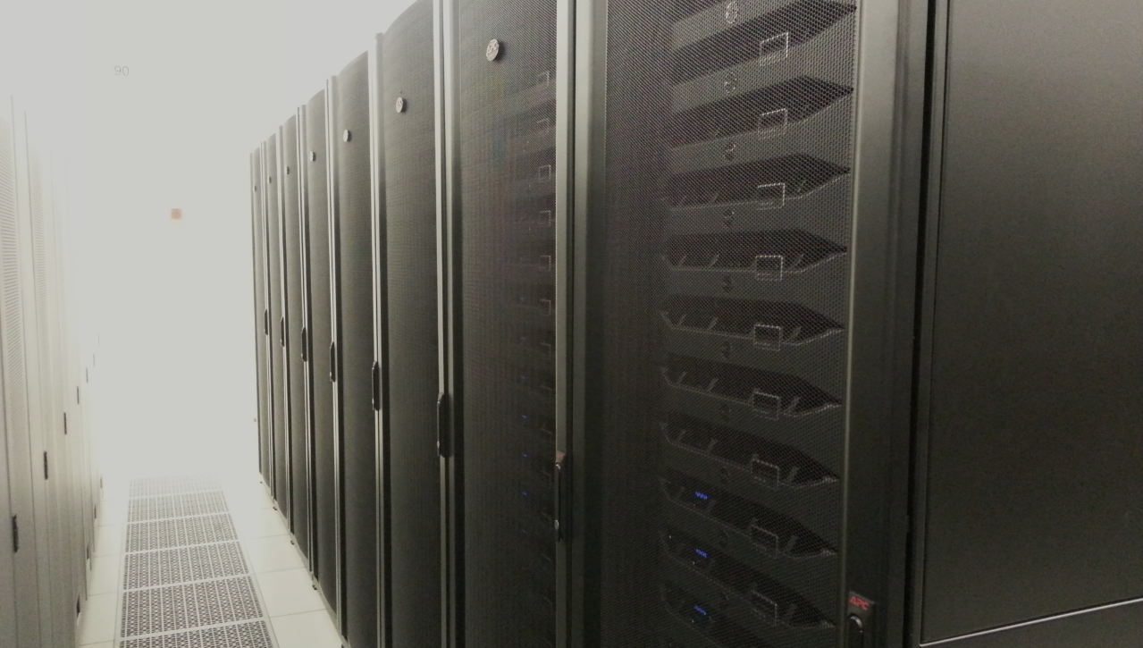
CyberGIS ROGER
Resourcing Open Geospatial Education and Research
after Roger Tomlinson
~60 TFlop/s
Notes:
Roger Tomlinson has been called the “Father of GIS” thanks to his leadership of the Canada Geographic Information System, the first computerized GIS.
The Tflops number for ROGER is theoretical, it has not been benchmarked.

Slide 8
Distributed Computing using Hadoop
What is Hadoop
Distributed file system + replicating data in multiple nodes.
Easy-to-use MapReduce interface.
Scalable.
Parallel execution of mappers/reducers.
Fault tolerant.
When to use Hadoop
Data is too big to fit into memory.
Tasks can be decomposed as batch-based processing.
The problem can be modeled by MapReduce computing paradigm.
Scalability is the major issue not interactivity.

Slide 9
Origins of MapReduce and Hadoop
MapReduce was developed in Google
Dean, J. and Ghemawat, S., 2008. MapReduce: simplified data processing on large clusters. Communications of the ACM, 51(1), pp.107-113.
Yahoo developed Hadoop
Shvachko, K., Kuang, H., Radia, S. and Chansler, R., 2010, May. The hadoop distributed file system. In Mass Storage Systems and Technologies (MSST), 2010 IEEE 26th Symposium on (pp. 1-10). IEEE.
Now Hadoop is an open source distributed computing framework, known as Apache Hadoop
http://hadoop.apache.org/

Slide 10
Characteristics of Hadoop
Distributed file system + replicating data in multiple nodes.
Easy-to-use MapReduce interfaces and libraries (e.g., Pig, Java, Hadoop Streaming API)
Scalable.
Parallel execution of mappers/reducers.
Fault tolerant.
Best practice for Hadoop
The problem can be modeled by MapReduce computing paradigm.
Scalability is the major issue not interactivity.

Slide 11
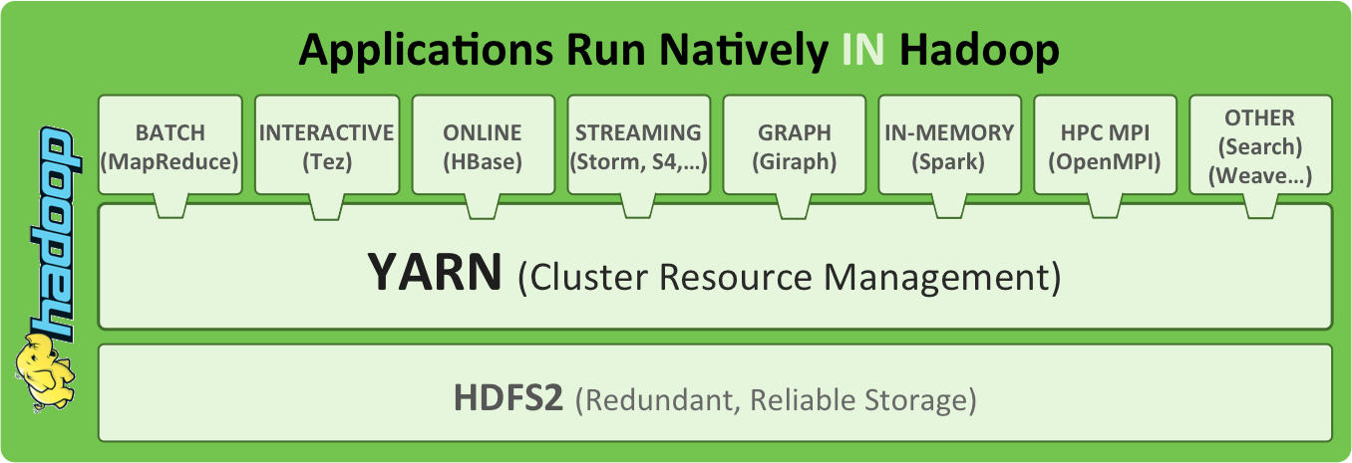
Hadoop Architecture
Source: http://radar.oreilly.com/2014/01/an-introduction-to-hadoop-2-0-understanding-the-new-data-operating-system.html
Notes:
Yahoo developed HDFS to compete with GFS (Google). Google developed MapReduce for their own system.
Yarn for resource management. Queue system.
Hbase – big table, column based database. OS version. SQL-like.
Hive for Hbase
Pig for raw data like loaded CSVs

Slide 12


HDFS
HDFS – Hadoop Distributed File System?
HDFS is the storage mechanism for Hadoop
Designed to scale easily and effectively
Designed to be deployed on low-cost hardware
HDFS components
NameNodes (the master) manage the filesystem namespace
Datanodes (workers) store and retrieve the chunks of data
NameNode
1
2
3
DataNode 1
DataNode 2
DataNode 3
DataNode 4
4
Notes:
Adding more nodes increase both storages space and computing throughput.
Data is too big store in one computer: data is stored on multiple computers.
Very high end machine are expensive: run on commodity hardware
Low-cost hardware will fail- replicate data –
How will the distributed nodes co-ordinate among themselves?
Putting a file into HDFS involves the following steps:
Clients sends a request to the namenode to add a file to HDFS.
Namenode tells client how and where to distribute the blocks.
Client breaks the data into blocks and writes each block to a datanode.
The datanodes replicate the newly-created blocks, based on instructions from the namenode.

Slide 13
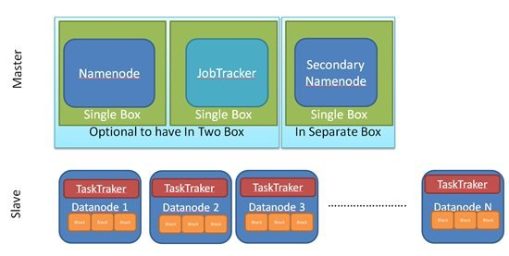
Terminologies
Notes:
The NameNode is the centerpiece of an HDFS file system. It keeps the directory tree of all files in the file system, and tracks where across the cluster the file data is kept. It does not store the data of these files itself.
Optional SecondaryNameNode that can be hosted on a separate machine.
Use the classroom to explain the terminologies

Slide 14
Terminologies
NameNode
manages the file system metadata for HDFS
DataNode
store the actual data
JobTracker
responsible for scheduling the jobs' component tasks on the TaskTrackers, monitoring them and re-executing the failed tasks
TaskTracker
execute the tasks as directed by the JobTracker
NameNode and JobTracker are the masters

Slide 15
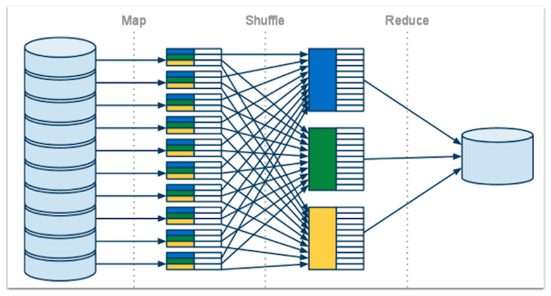
MapReduce computing paradigm
Notes:
Map: filtering and sorting
Reduce: summary

Slide 16
Example: word count in a corpus
Find the frequency of words in a text corpus.
Input: Bag of words =>
“Research”, “Student”, “GIS”, “CIGI”, “Student”, “Geospatial”, “Research”, “Center”, “GIS”, “Research”, “CIGI”, “Research”, “Geospatial”, “GIS”
Output – <Word, Frequency>
Research | 4
Student | 2
CIGI | 2
Center | 1
GIS | 3
Geospatial | 2
Notes:
The concept of <key, value> pairs

Slide 17
Mapper
Key | Value
Research | 1
Student | 1
GIS | 1
CIGI | 1
Student | 1
Geospatial | 1
Research | 1
Research
Student
GIS
CIGI
Student
Geospatial
Research
Mapper
1
Key | Value
Center | 1
GIS | 1
Research | 1
CIGI | 1
Research | 1
Geospatial | 1
GIS | 1
Center
GIS
Research
CIGI
Research
Geospatial
GIS
Mapper
2
Notes:
Point weights as an option, applying values, perhaps by category or spatial bounding box.

Slide 18
Shuffle
CIGI | 1
CIGI | 1
Key | Value
Research | 1
Student | 1
GIS | 1
CIGI | 1
Student | 1
Geospatial | 1
Research | 1
Geospatial | 1
Geospatial | 1
GIS | 1
GIS | 1
GIS | 1
Research | 1
Research | 1
Research | 1
Research | 1
Key | Value
Center | 1
GIS | 1
Research | 1
CIGI | 1
Research | 1
Geospatial | 1
GIS | 1
Student | 1
Student | 1
Center | 1

Slide 19
Reducer
Key | Value
CIGI | 2
CIGI | 1
CIGI | 1
Geospatial | 1
Geospatial | 1
Key | Value
Geospatial | 2
GIS | 1
GIS | 1
GIS | 1
Key | Value
GIS | 3
Research | 1
Research | 1
Research | 1
Research | 1
Key | Value
Research | 4
Key | Value
Student | 2
Student | 1
Student | 1
Key | Value
Center | 1
Center | 1
Notes:
Summary.

Slide 20
Combiner
Key | Value
Research | 1
Student | 1
GIS | 1
CIGI | 1
Student | 1
Geospatial | 1
Research | 1
Key | Value
Research | 2
Student | 2
GIS | 1
CIGI | 1
Geospatial | 1
Mapper
Output
Key | Value
Center | 1
GIS | 1
Research | 1
CIGI | 1
Research | 1
Geospatial | 1
GIS | 1
Key | Value
Center | 1
GIS | 2
Research | 2
CIGI | 1
Geospatial | 1
Notes:
Run in the memory of the mapper.

Slide 21
Reducer + Combiner
Key | Value
CIGI | 2
CIGI | 1
CIGI | 1
Geospatial | 1
Geospatial | 1
Key | Value
Geospatial | 2
GIS | 1
GIS | 2
Key | Value
GIS | 3
Research | 2
Research | 2
Key | Value
Research | 4
Key | Value
Student | 2
Student | 2
Key | Value
Center | 1
Center | 1

Slide 22
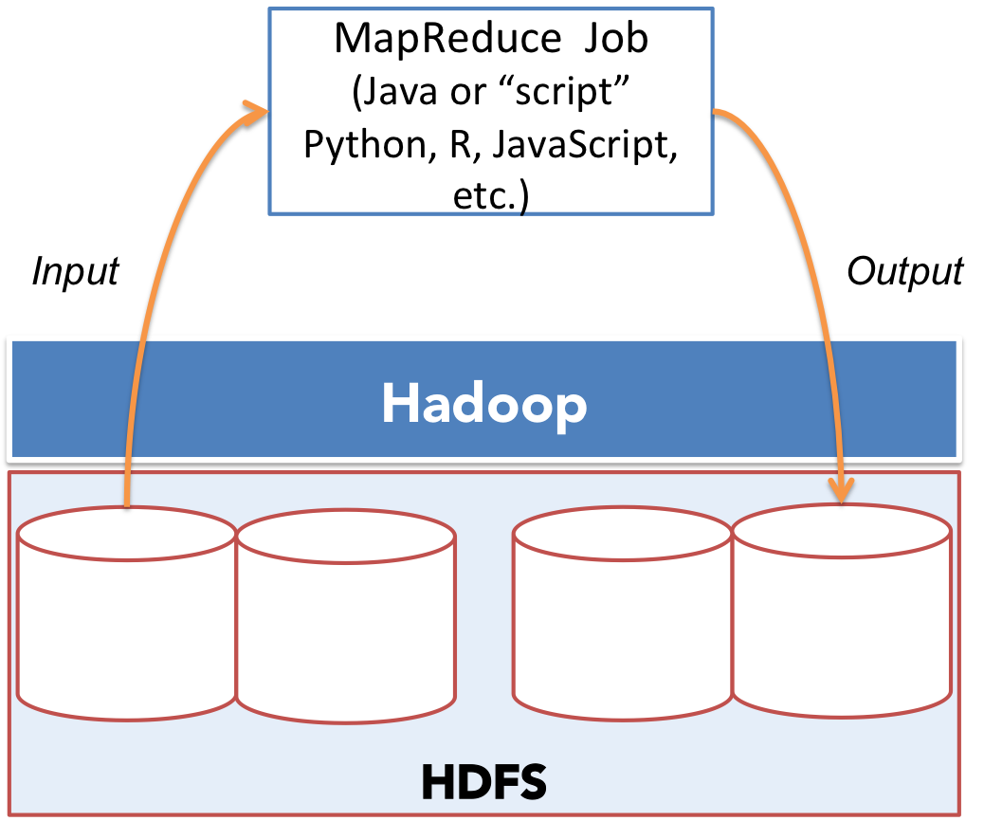
Hadoop Streaming API: Delegation of Map and Reduce tasks

Slide 23
Basic Hadoop Commands
Check Hadoop directory
hdfs dfs -ls [/user/netID/folder]
hdfs dfs -ls folder
Make a Hadoop directory
hdfs dfs -mkdir folder
Copy data into HDFS
hdfs dfs -copyFromLocal local_file [path_in_HDFS]
Copy data from HDFS to local directory
hdfs dfs -getmerge file_in_HDFS path_in_local_directory
Delete files from HDFS
hdfs dfs -rm -r file_in_HDFS

Slide 24
Hadoop in ROGER
Dedicated Hadoop Cluster
Computing nodes: cg-hm08 – cg-hm18
http://cg-hm08.ncsa.illinois.edu:50070/
175TB currently allocated (capacity on site above is incorrect)
How to access
Login to ROGER first
ssh your_netID@roger-login.ncsa.illinois.edu
Login to the master node: cg-hm08
ssh cg-hm08

Slide 25
Case Study: New York taxi pick-up and drop-off density maps at the traffic analysis zone (TAZ) level

Slide 26
Taxi Data
January 2013 Taxi Trips from FOIA (Freedom of Information Act) request from Chris Whong
(http://www.andresmh.com/nyctaxitrips/)
Trip:
medallion, hack_license, vendor_id, rate_code, store_and_fwd_flag, pickup_datetime, dropoff_datetime, passenger_count, trip_time_in_secs, trip_distance, pickup_longitude, pickup_latitude, dropoff_longitude, dropoff_latitude Fare:
medallion, hack_license, vendor_id, pickup_datetime, payment_type, fare_amount,surcharge, mta_tax, tip_amount, tolls_amount, total_amount
Notes:
Explain code

Slide 27
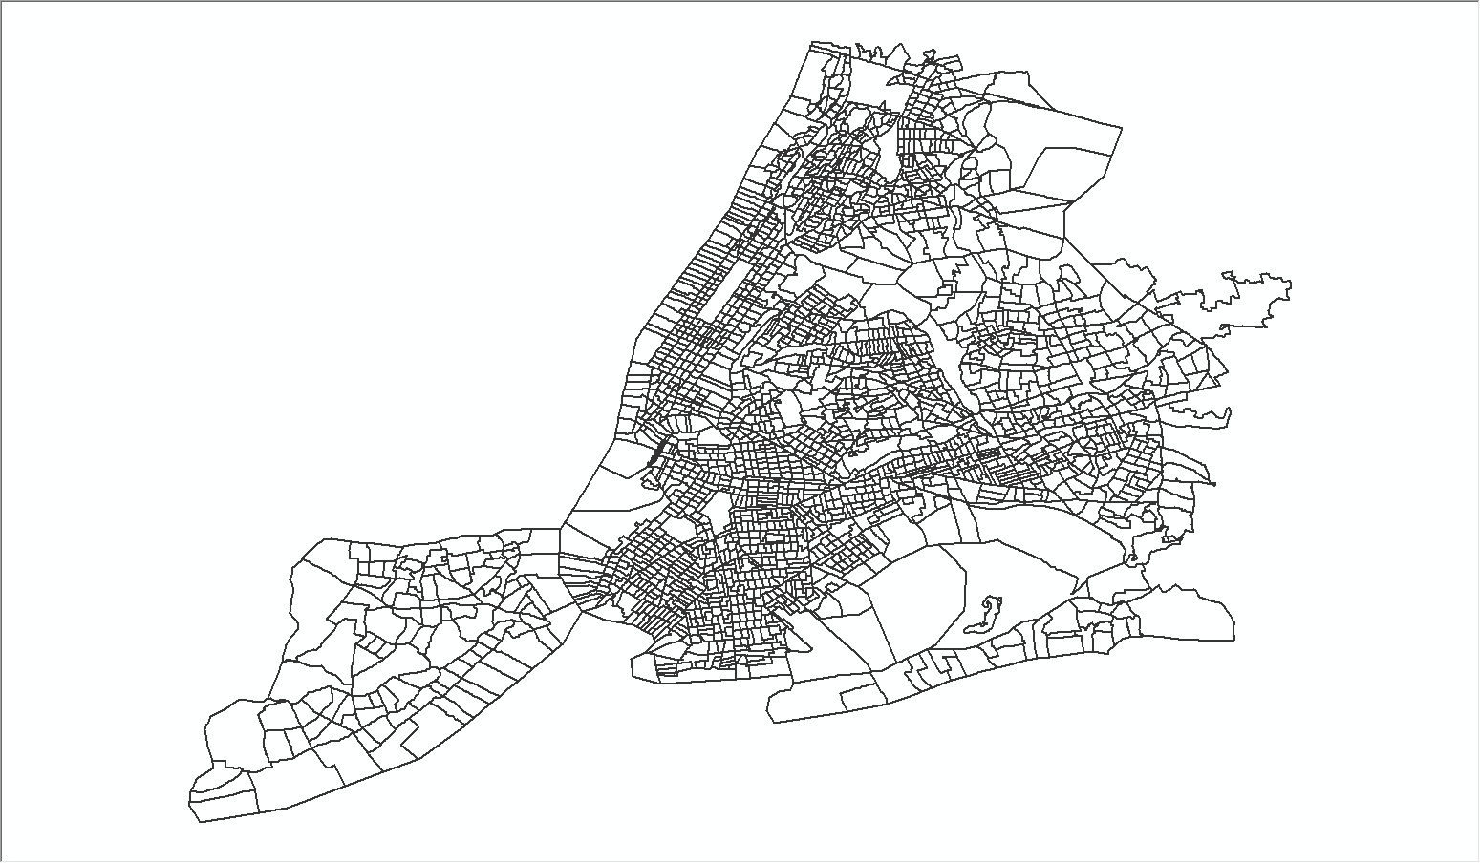
NYC Traffic Analysis Zones
Notes:
2250 polygonal units

Slide 28
MapReduce for Density maps
Two types of density maps
Grid/cell-based
polygonal unit based
What does “density” mean and how to represent it?
This step is essential in terms of converting the problem set into a MapReduce way
Basically, <Key, Value> pairs should be defined clearly
What is the “Key”
What is the ”Value”

Slide 29
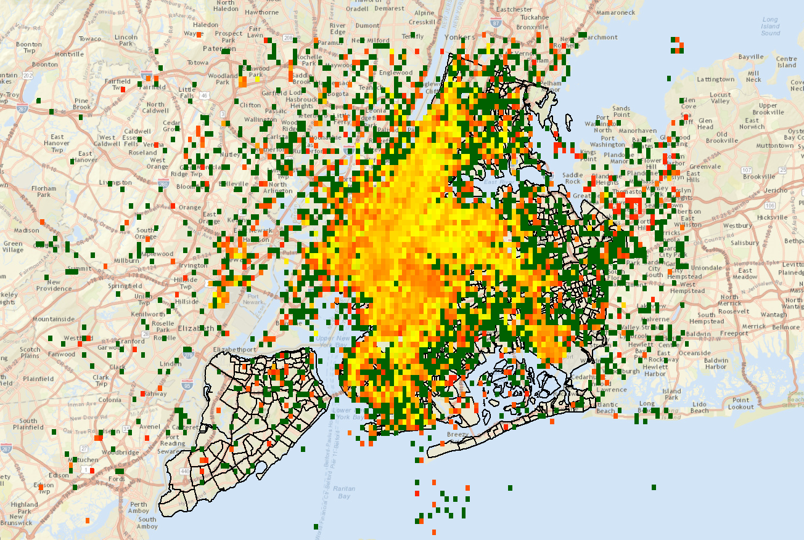
New York taxi pickup passenger density map

Slide 30
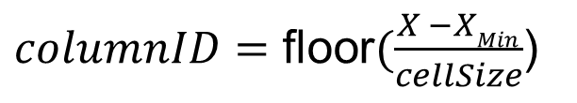
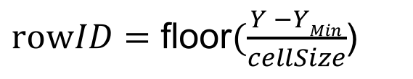
Find the cell number (index) that a point belongs to:
(X_{Min}, Y_{Max})
(xMax, Y_{Max})
[6,0]
[5,0]
[4,0]
[3,0]
[2,0] | [2,1] | [2,2]
[1,0] | [1,1] | [1,2]
[0,0] | [0,1] | [0,2] | [0,3] | [0,4] | [0,5]
$columnID=\text{floor}(\frac{X −XMin}{cellSize}$)
$rowID=\text{floor}(\frac{Y −YMin}{cellSize}$)
(X_{Min}, Y_{Min})
(X_{Max}, Y_{Min})

Slide 31
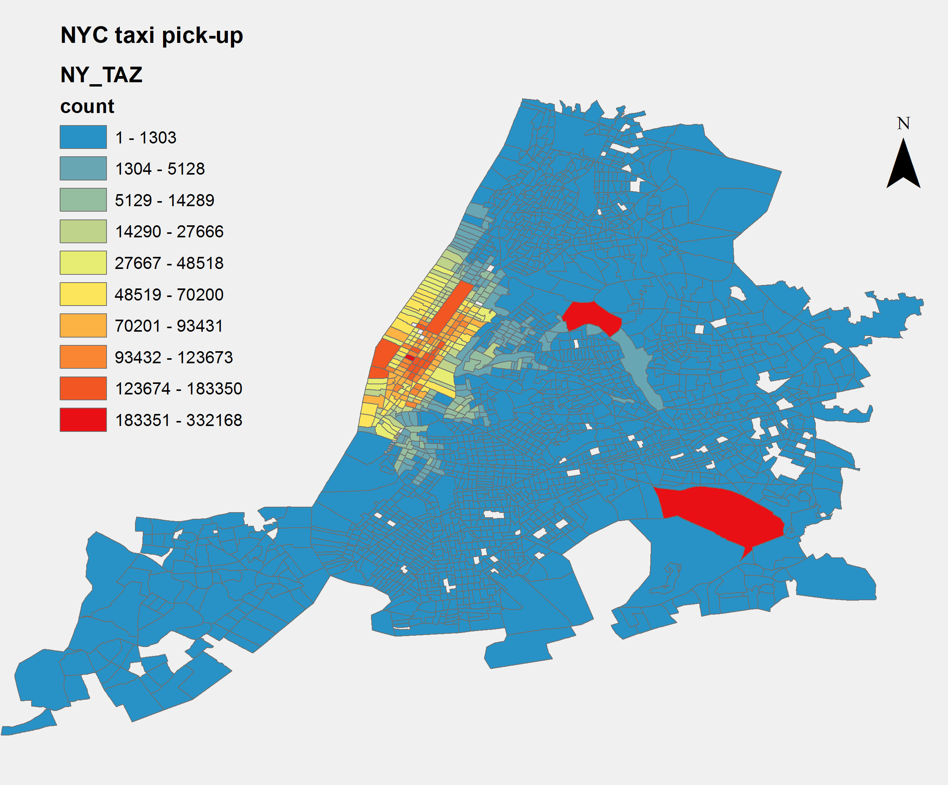
New York taxi pickup density map (TAZ level)

Slide 32
Implementations
ESRI Geometry API for Java
Start coding from scratch
Explicitly design Map and Reduce
Full control but complicated in programming
Spatial indexing and geospatial relations support
Spatial Framework for Hadoop
Easy to understand and operate with Hive Query Language
Less control for <key, value> pair operations
No spatial indexing, but geospatial relations support
Hadoop Streaming API with Python
Easy to understand and
More control for <key, value> pair operations
Spatial indexing and geospatial relation support (own implementations)
Notes:
Explain code

Slide 33
GIS Tools for Hadoop by ESRI
Understanding spatial relations
http://edndoc.esri.com/arcsde/9.0/general_topics/understand_spatial_relations.htm
ESRI java Geometry Library
https://github.com/Esri/geometry-api-java/wiki
ESRI Java geometry library Relational operations:
http://esri.github.io/geometry-api-java/doc/Contains.html
http://esri.github.io/geometry-api-java/javadoc/com/esri/core/geometry/GeometryEngine.html

Slide 34
Improve efficiency with spatial indexing
The purposes of spatial index
Improve search efficiency
Deal with multi-dimensional dataset
Different types of spatial index
Quad-Tree
R-Tree
octree
Kd-tree
….
For this course, we will demonstrate and use Quad-Tree

Slide 35
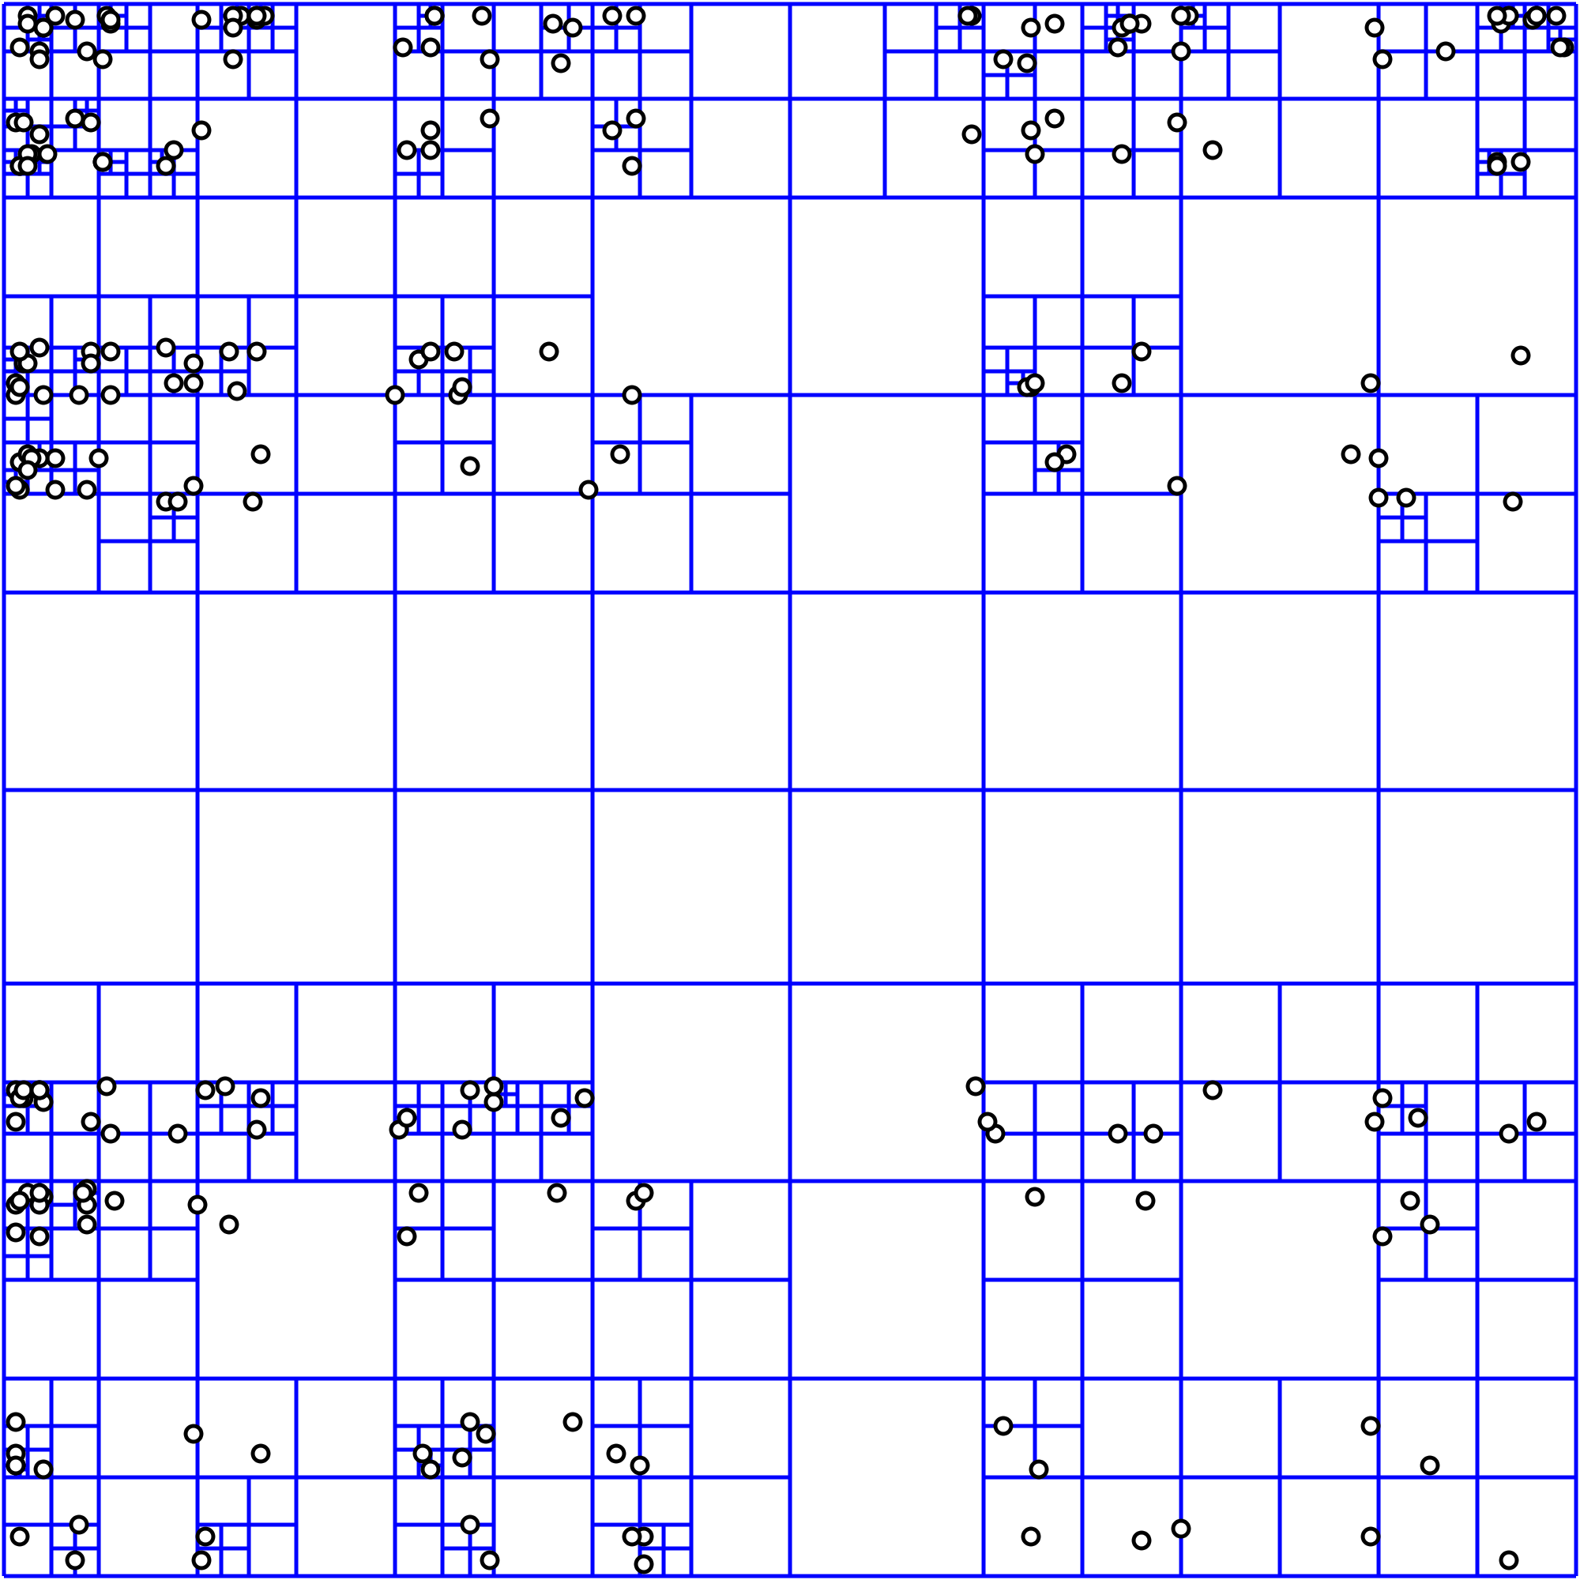
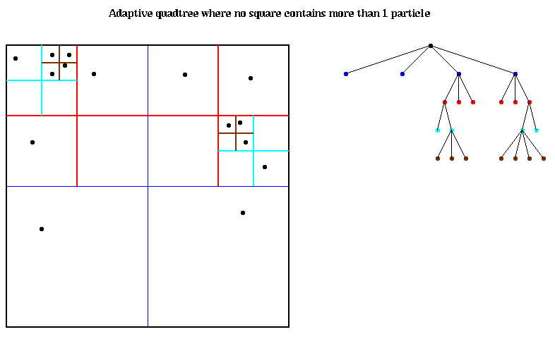
Illustration of Quad-Tree for indexing points

Slide 36
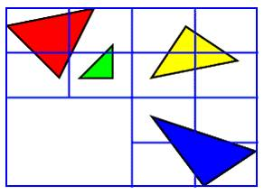
Illustration of Quad-Tree for polygons

Slide 37
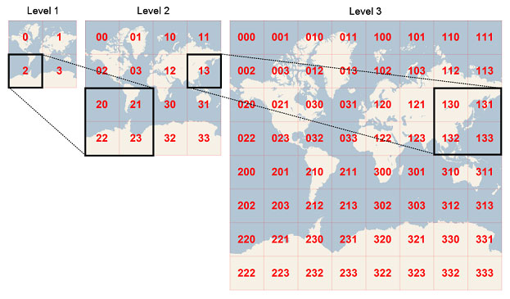
Applications of Quad-Tree

Slide 38
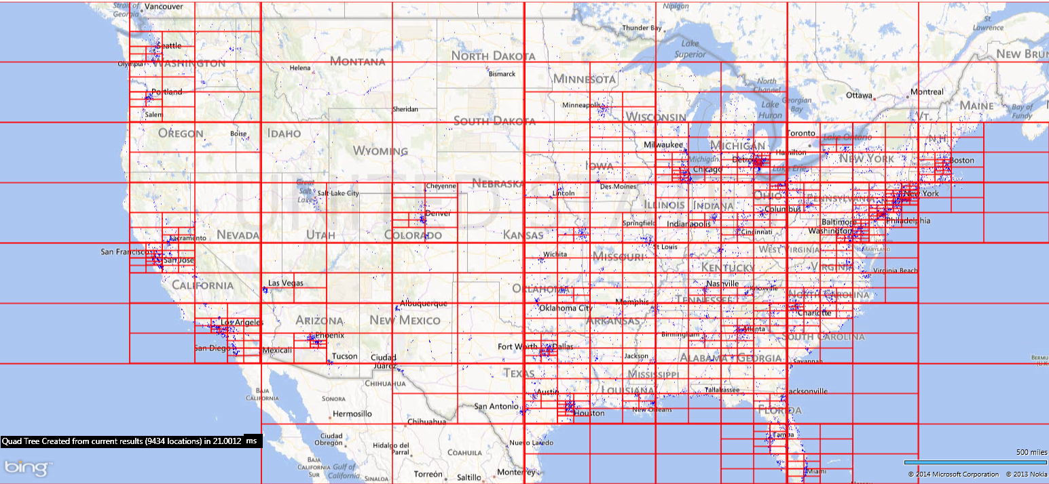
Applications of Quad-Tree
Source: http://softwareunwound.com/2014/03/18/adventures-in-mapping-big-data-sets-in-real-time-map-controls-part-2-enter-the-quadtree/

Slide 39

Hands-on

Slide 40
Code repository
The source code for this workshop is located in
/projects/EOT/workshops/geospatial_hadoop
To work with Hadoop, you need to log-in to our hadoop environment first
ssh cg-trnXX@roger-login.ncsa.illinois.edu
ssh cg-hm08
Copy the folder to your home directory
cp -r /projects/EOT/workshops/geospatial_hadoop ~/
cd ~/geospatial_hadoop
Notes:
Explain code

Slide 41
Preparing data in HDFS
How to deal with ESRI’s Shapefile
ArcGIS toolkit works with JSON instead of Shapefile directly
All Shapefile should be converted to JSON files first
All data should be put in the HDFS
We will go through them together step by step
Notes:
Explain code

Slide 42
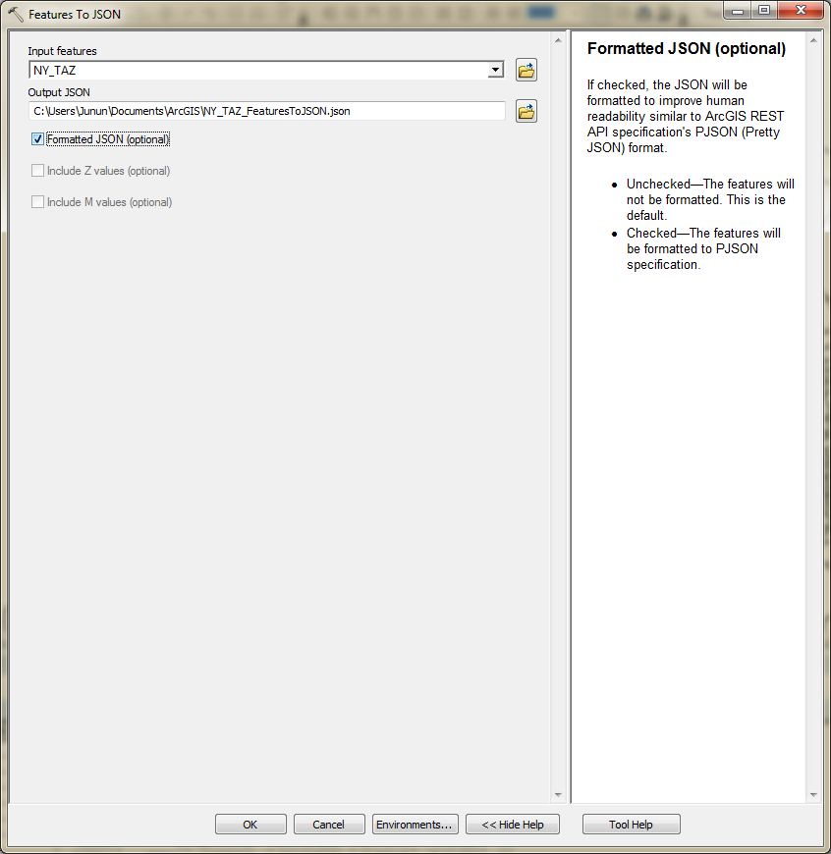
Converting Feature class to JSON
Notes:
Explain code

Slide 43
Java-based MapReduce
The source code for this workshop is located in
~/geospatial_hadoop/point-in-polygon-aggregation-java
To view and edit the source code
cd point-in-polygon-aggregation-java
cd src/com/esri/hadoop/examples/
To run the program
cd ~/geospatial_hadoop/point-in-polygon-aggregation-java/cmd
Edit the configuration file
And run the bash file: ./run-sample.sh
If any new edits are added, the program needs to be re-compiled
cd ~/geospatial_hadoop/point-in-polygon-aggregation-java
module load ant
ant clean
ant compile jar
Notes:
Explain code

Slide 44
Hive Query
The source code for this workshop is located in
~/geospatial_hadoop/point-in-polygon-aggregation-hive
To enable Hive
hive
Or hive -S (S stands for silent mode)
Edit the Hive script accordingly
Run the Hive script
source script_name.sql
Quit the Hive environment
exit; or quit;
Notes:
Explain code

Slide 45
Hadoop Streaming API based (Python)
The source code for this workshop is located in
/projects/EOT/workshops/geospatial_hadoop/point-in-polygon-aggregation-python
The cell-based program is located in
/projects/EOT/workshops/geospatial_hadoop/ny_taxi
You need to put the taxi records data into HDFS manually
hdfs dfs –copyFromLocal ny_taxi_1.csv
Notes:
Explain code

Slide 46
Thanks!
Comments / Questions?
Junjun Yin: jyin@psu.edu

